Slide 1
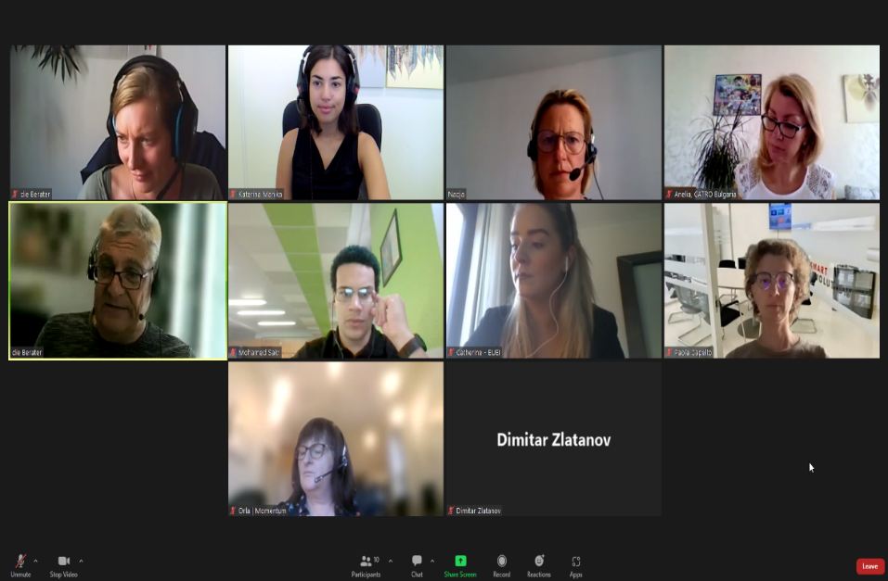







Newsletter September 2022
WHAT IS PROSPER?
PROSPER Project has been formed as a strategic partnership to design, develop and implement a new training approach which empowers SMEs managers to reimagine their challenging role as remote managers and ensure remote employees balance between digital productivity, wellbeing and inclusion.
OUR OBJECTIVES
Developing a new training for SMEs managers, Team leaders and HR staff to update their leadership and management skills for remote as well as hybrid settings.
Fulfilling the specific training needs of SMEs, while incorporating wider aspects of digitalization, digital inclusion and digital wellbeing.
Adapting the Vocational Education and Training (VET) to meet labour market needs due to the digital transformation fueled by the COVID-19 pandemic repercussions.
Altogether, adapting vocational education and training to the emerging labour market needs.
THE PROJECT PARTNERS
The European Commission’s support for the production of this publication does not constitute an endorsement of the contents, which reflect the views only of the authors, and the Commission cannot be held responsible for any use which may be made of the information contained therein.

Slide 2


PROGRESS SO FAR
Meetings
The PROSPER partners came together in Vienna to kick-off the project on 29 and 30 of March 2022 and held the 2nd Transnational Project Meeting virtually on 7 and 8 of September 2022.
Result 1a
The project is producing a
Report on Hybrid Working
which will be the basis for the Business Case for Healthy Hybrid Working in European SMEs supported with several interviews from SMEs managers and employees.
Project Website
The project’s website has been launched with all information and is soon to be translated in six languages.
www.prosper-project.eu
NEXT STEPS
Result 1b
The next months will be dedicated to developing the core Business Case which will address SME managers. This will be a precise publication with the main takeaways to be considered in practice.
Result 2
After the finalization of the Business Case, the project will further develop a compact Online Training Course for SME managers and relevant staff that coordinate hybrid teams.
Result 3
Based on the previous results, a comprehensive and pragmatic Empowerment Program will be developed to offer a train-the-trainer opportunity and multiply the results through in-person trainings for SMEs managers, team leaders, and HR staff.
CALL FOR ACTION
Share your experiences and best practices regarding hybrid work and be a part of our Business Case by contacting our team!
The European Commission’s support for the production of this publication does not constitute an endorsement of the contents, which reflect the views only of the authors, and the Commission cannot be held responsible for any use which may be made of the information contained therein.

